Slide 1
Goals and functional requirements
[G1] Allow customers to access the system’s taxi service in any moment, whether they are at home or anywhere else in the city.
[R1] Customers should be able to access the service through both the web and the mobile application, even at the same time.
[R2] Customers must be able to register to the taxi service from the mobile or web homepage.
[R3] Only registered customers can access MTS’s services.
[R4] The system should allow the log out functionality.

Slide 2
Goals and functional requirements
[G2] Allow customers to request a taxi ride from an arranged location.
[R1] Only registered customers can request a taxi ride.
[R2] Customers must insert a valid origin location in order to request a ride.
[R3] The system will not allow more than a request if the previous one (either request or reservation) has not been accomplished yet.

Slide 3
Goals and functional requirements
[G3] Allow customers to reserve a taxi ride at a specific time with a given origin and destination.
[R1] The system should allow taxi reservations for a specific path communicated by the customer.
[R2] The system must not allow overlaps between reservations (or requests) made by the same customer.
[R3] The system allows reservations only 2 hours before the time and date specified by the customer.
[R4] The system will assign a taxi driver for the reserved ride 10 minutes before the time and date specified by the customer.

Slide 4
Goals and functional requirements
[G4] Allow taxi drivers to answer a ride request and take care of customers.
[R1] Taxi drivers should be able to communicate their current availability state to the system.
[R2] If available, taxi drivers should be able to receive incoming requests.
[R3] After receiving an incoming request, the taxi driver should be able to either confirm or not his intention to take charge of the request.
[R4] Taxi drivers must be able to log in the mobile application with preassigned credential and be identified as drivers.

Slide 5
Goals and functional requirements
[G5] A ride request should always be satisfied within a considerable short amount of time, 15 minutes on average.
[R1] The system should always search an available taxi giving maximum priority to the taxi zone related to the request and lower priority to the immediate near zones. Any other taxi zone should be ignored.
[R2] If no taxis are available in the zones specified in the previous requirement, the system should put the request on hold and periodically check again the taxi availability.

Slide 6
Goals and functional requirements
[G6] Allow customers to be notified of any relevant update connected to their requests and reservations.
[R1] The system should send updates through email and/or in-app notification, as specified by the customer.
[R2] Absence of taxis available, reservations overlaps, taxi average waiting time and taxi assigned to customers are events that must be notified to the customer.

Slide 7
Goals and functional requirements
[G7] Customers and taxi drivers must be able to contact each other after the system has paired them.
[R1] Customers must leave a valid phone number in order to complete the registration phase.
[R2] Taxi drivers must be able to access to the customer’s phone number when the system has paired them.
[R3] Customers must receive the taxi drivers’ contact number after the system has paired them.
[R4] Customers must receive the taxi code in order to be able to recognize its driver.

Slide 8
Goals and functional requirements
[G8] Allow customers to delete requests and reservations.
[R1] Customers can delete a request or reservation only if it has not been assigned to a taxi driver yet.

Slide 9
Goals and functional requirements
[G9] Administrators must be able to assign and manage an account to the taxi drivers hired by the company.
[R1] Administrators must be able to create a taxi driver’s account.
[R2] Administrators must be able to delete a taxi driver’s account.

Slide 10
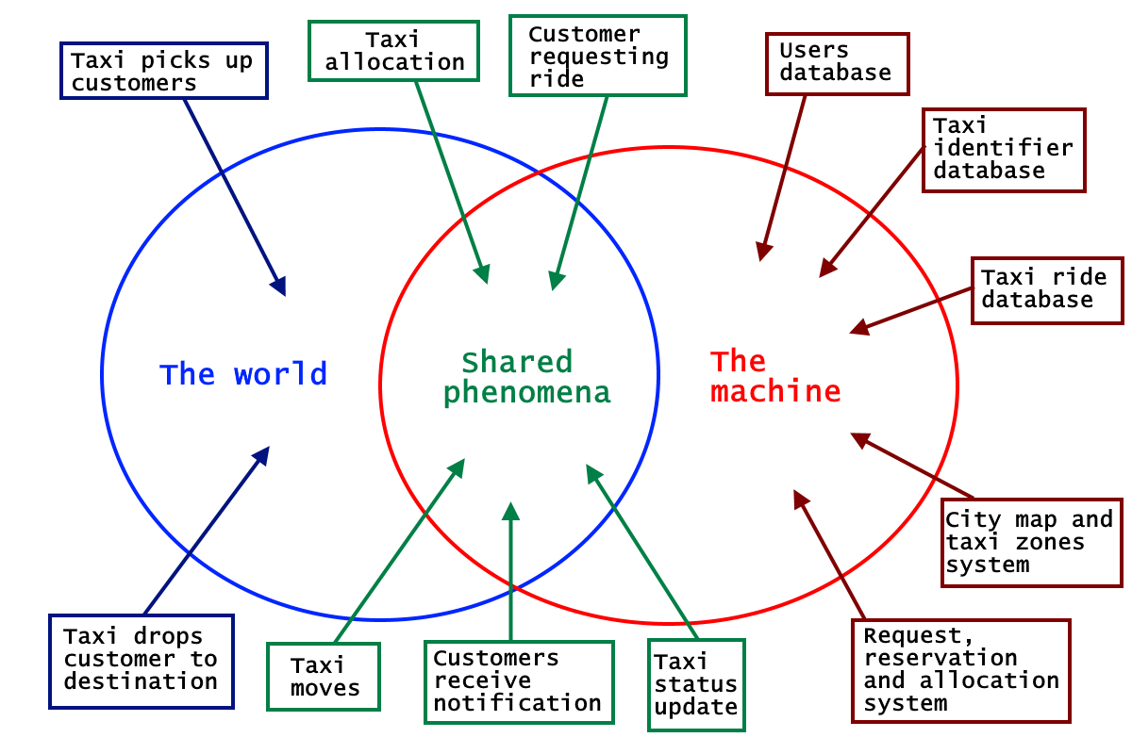
The world and the machine

Slide 11
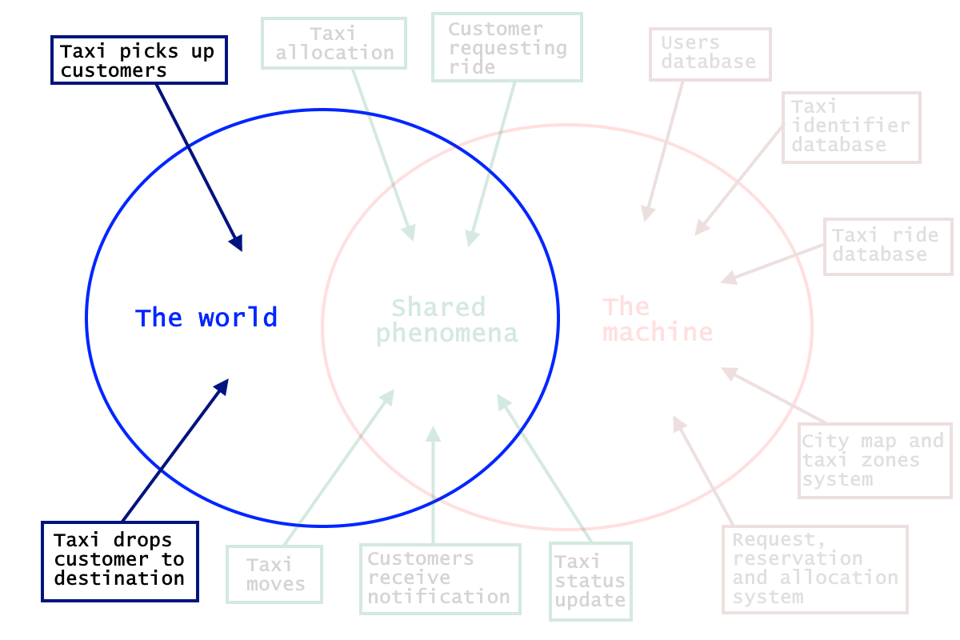
The world
Taxi picks up customers – happens exclusively in the world and it is not observed by the machine
Taxi drops customers to destination – it is not seen by the machine, which can only see the driver’s change of status

Slide 12
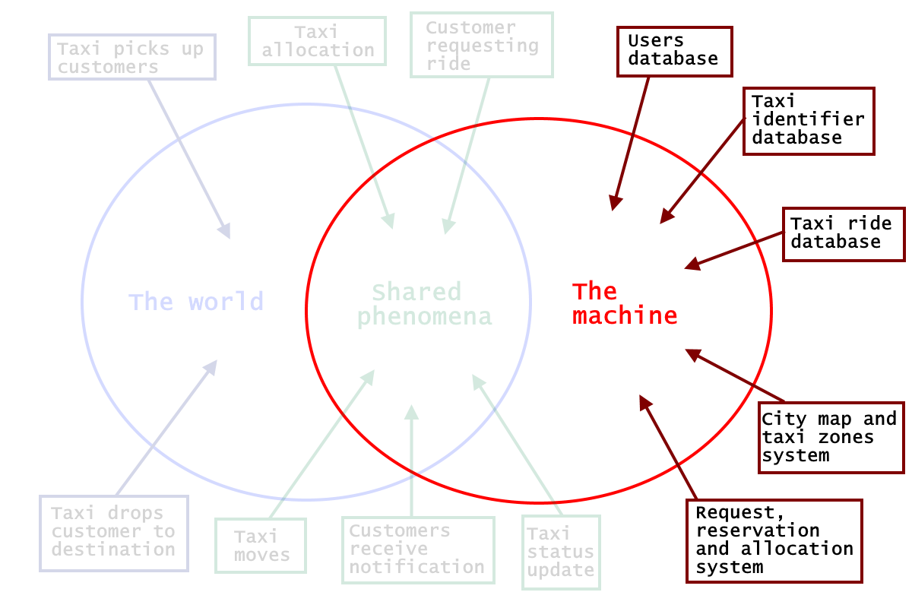
The machine
Users database – Contains all the users’ accounts: Admins, Taxi drivers and Customers
Taxi identifier database - contain all the information about taxis and their assigned drivers.
Taxi ride database - Store all the information regarding actual, past and future taxi rides
City map and taxi zones system – Contains and manages the taxi zones and the queues
Request, reservation and allocation system – manages the main application logic

Slide 13
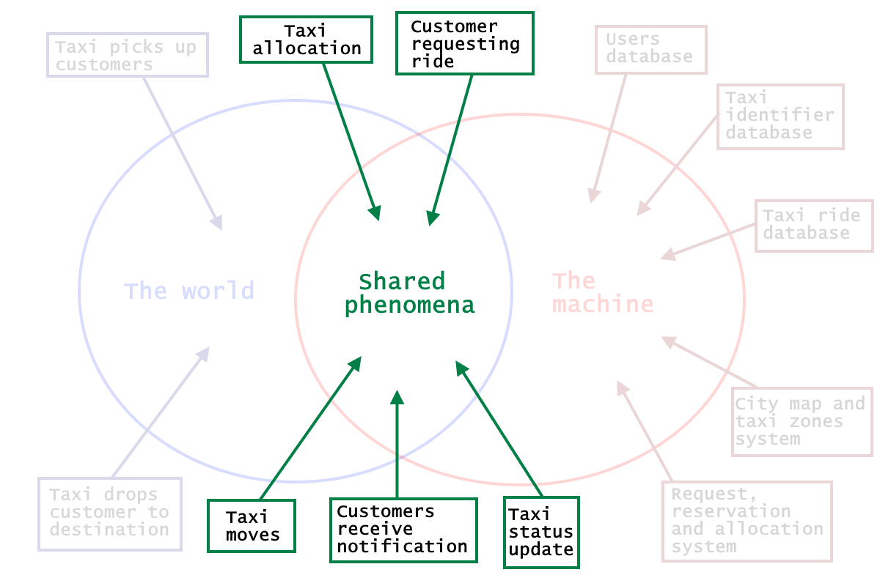
The Shared Phenomena
Taxi allocation - is a particular entity: if we consider MTS customers, is observed by the world and controlled by the machine (which sets the taxi’s next destination accordingly to the customer requests); if we consider standard customers, then it is observed by the machine (with the GPS and taxi zones system) and controlled by the world (i.e. the standard customer).
Customer requesting ride - happens in the world and is only observed by the machine, which will react accordingly.
Taxi moves - is a shared phenomenon, which is controlled by the world and observed by the machine through the GPS system.
Taxi status update - is also a phenomenon controlled by the world (i.e. the taxi driver that changes their status by picking up and dropping of customers) and observed by the system.
Customers receive notifications - is machine-controlled, since customers receive updates about their rides by the system.

